Slide 1
The TCP / IP Protocol Suite

Slide 2
1.1 The Internet Today, World Wide web
The Internet today is a vast global network that connects billions of computers and electronic devices worldwide. It enables communication, information sharing, entertainment, commerce, and social networking through high-speed data transmission over a complex system of interconnected networks using standard protocols like TCP/IP. The Internet has grown to cover a large portion of the global population, with more than 67% users worldwide as of 2023, facilitating various services such as email, VoIP, video calls, video streaming, online gaming, and more. It continuously evolves, driven by advances in technology, higher bandwidth, and the integration of wireless and mobile devices, shaping how people access and use information globally.
The World Wide Web (WWW), often called the Web, is an information system built on top of the Internet that makes it easy for users to access and share documents and multimedia content via web browsers. It was invented by Tim Berners-Lee in 1989 as a "universal linked information system," enabling retrieval and navigation of documents through hyperlinks. The Web uses fundamental technologies like HTTP (Hypertext Transfer Protocol), HTML (Hypertext Markup Language), and URLs (Uniform Resource Locators) to create and access interconnected web pages stored on web servers. It has become the dominant platform for information dissemination on the Internet, allowing billions of people to browse websites, watch videos, shop online, and interact through social media and web applications

Slide 3
To summarize:
Topic | Description
Internet Today | Global network connecting billions of devices, enabling communication and data exchange using protocols like TCP/IP, supporting various online services and applications.
World Wide Web | A system built on the Internet for accessing linked documents and multimedia using browsers via HTTP, HTML, and URLs; created by Tim Berners-Lee in 1989.
1.2 Protocols and Standards ,Standards Organizations
Protocols and standards are fundamental for the Internet's operation, ensuring devices and networks can communicate efficiently and compatibly. Protocols are agreed-upon rules governing how data is transmitted, received, and interpreted across networks. Standards formalize these protocols and other technical specifications to maintain interoperability among

Slide 4
Key points about protocols and standards:
Protocols define the syntax, semantics, and synchronization of communication between devices (e.g., TCP/IP, HTTP, FTP).
Standards ensure compatibility and universal implementation of technologies, enabling global connectivity.
The evolution of Internet protocols includes major innovations like TCP/IP for reliable communication and newer protocols addressing security and scalability
Standards organizations oversee the development, validation, and dissemination of these protocols and standards. Major global organizations involved include:
Internet Engineering Task Force (IETF): The primary body responsible for developing Internet standards through a transparent, consensus-driven process. It publishes technical documents called RFCs (Request for Comments).
Internet Architecture Board (IAB): Provides oversight and architectural guidance for Internet development, supervising the IETF.
Internet Research Task Force (IRTF): Focuses on longer-term research relevant to Internet protocols and technology.
World Wide Web Consortium (W3C): Develops web standards to ensure the interoperability of web technologies like HTML, CSS, and XML.

Slide 5
International Organization for Standardization (ISO): Develops broad international standards, including those related to networking (OSI model).
American National Standards Institute (ANSI): Oversees standards in the United States and manages codes like ASCII.
Other specialized bodies include Unicode Consortium (for universal character encoding) and ECMA International (for programming standards like JavaScript).
1.3 Protocol Layers: Hierarchy, Services
Protocol layers are organized in a hierarchical model that structures communication functions into discrete levels, each with specific responsibilities. This hierarchical layering helps in separating concerns, simplifying design, allowing interoperability, and enabling protocols to work together effectively.
Protocol Layers Hierarchy
A widely accepted model for understanding protocol layers is the OSI (Open Systems Interconnection) Model, which consists of seven layers arranged from lowest (physical media) to highest (application level):

Slide 6
Physical Layer (Layer 1): Handles the transmission of raw bits over a physical medium such as cables or wireless signals. It deals with electrical, mechanical, and procedural interfaces.
2.Data Link Layer (Layer 2): Responsible for node-to-node data transfer, framing, error detection and correction, and flow control within a single network segment.
3.Network Layer (Layer 3): Manages routing and forwarding of data packets across interconnected networks, handling logical addressing and path determination.
4.Transport Layer (Layer 4): Ensures reliable data transfer between end systems with error recovery, flow control, and segmentation.
.Session Layer (Layer 5): Controls sessions or connections between applications, managing opening, maintaining, and closing communication sessions.
6.Presentation Layer (Layer 6): Translates data formats, encrypts/decrypts data, and compresses/decompresses to provide a syntax understood by the application layer.
7.Application Layer (Layer 7): Provides network services directly to user applications, supporting protocols like HTTP, FTP, SMTP, and DNS.

Slide 7
Services Provided by Each Layer
Physical Layer: Bit transmission over medium, bit synchronization, transmission mode control.
Data Link Layer: Framing, physical addressing, error notification, flow control, and access control.
Network Layer: Logical addressing, routing, packet forwarding, congestion control.
Transport Layer: End-to-end communication, reliability, error correction, data segmentation and reassembly.
Session Layer: Session establishment, maintenance, synchronization, and termination.
Presentation Layer: Data translation, encryption, decryption, compression.
Application Layer: High-level APIs, resource sharing, remote file access, email, web services.
This layered approach allows a modular and interoperable networking system where each layer can evolve independently as long as it maintains defined interfaces with adjacent layers.
The OSI model serves both as a theoretical framework and a practical guide for implementing network protocols and understanding their interaction

Slide 8
1.4 Reference Models: Introduction to OSI Reference Model and TCP/IP Protocol Suite:
introduction to OSI Reference Model and TCP/IP Protocol Suite
The OSI (Open Systems Interconnection) Reference Model and the TCP/IP Protocol Suite are foundational frameworks for understanding and implementing network communications.
OSI Reference Model
The OSI model is a conceptual framework developed by the International Organization for Standardization (ISO) that divides network communication into seven abstract layers to standardize and guide interoperability between different systems and technologies.

Slide 9
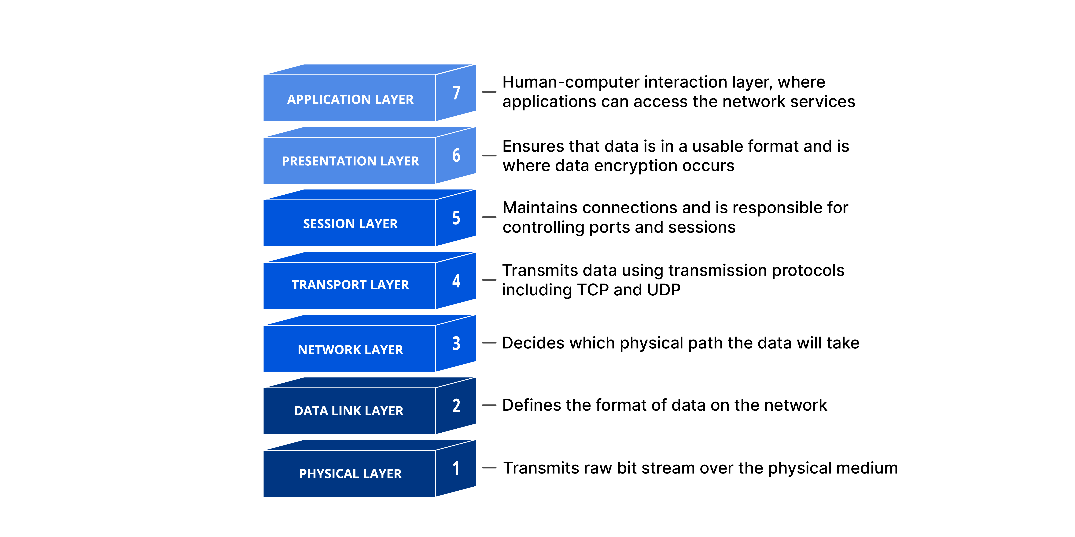

Slide 10
OSI Model Layers (from bottom to top):
Physical Layer: Handles transmission and reception of raw bit streams over a physical medium like cables or wireless.
2.Data Link Layer: Provides node-to-node data transfer, framing, error detection/correction, and manages access to the physical medium.
3.Network Layer: Responsible for logical addressing (IP addressing), routing, and forwarding packets across multiple networks.
4.Transport Layer: Provides reliable data transfer, flow control, error recovery, and segmentation of data into smaller units.
5.Session Layer: Manages sessions or dialogues between applications by establishing, maintaining, and terminating connections.
6.Presentation Layer: Translates data formats, handles encryption/decryption, and data compression/decompression to ensure data is readable at the application layer.
7.Application Layer: The top layer directly facing end-user applications, providing network services such as HTTP, FTP, SMTP, and DNS.
Each layer serves the layer above it and is served by the layer below it, creating a modular approach to network communication.

Slide 11
TCP/IP Protocol Suite
The TCP/IP suite is the practical and dominant protocol set used on the Internet, derived from the OSI concepts but more streamlined. It is structured into four abstraction layers:
1.Link Layer (Network Interface): Corresponds to OSI’s physical and data link layers. It handles hardware addressing and the physical transmission.
2.Internet Layer: Maps to OSI’s network layer, responsible for logical addressing and routing of packets, primarily using the Internet Protocol (IP).
3.Transport Layer: Corresponds to OSI’s transport layer, providing end-to-end communication services. Key protocols include Transmission Control Protocol (TCP) for reliable communication and User Datagram Protocol (UDP) for faster, connectionless transmissions.
4.Application Layer: Combines OSI’s session, presentation, and application layers. It handles protocols such as HTTP, FTP, SMTP, DNS, and others that provide services directly to applications.

Slide 12
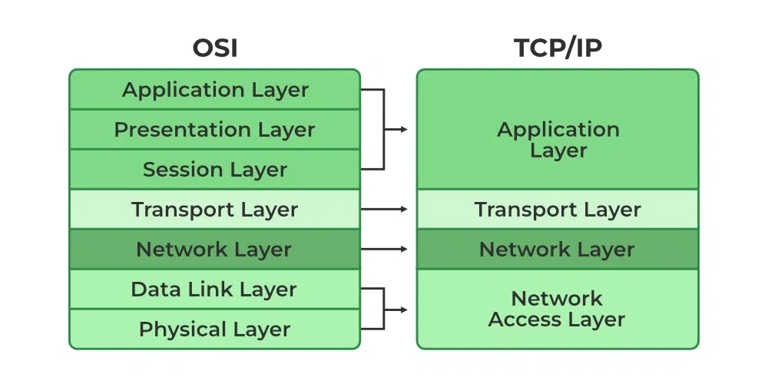
Working of TCP/IP Model
The working of TCP/IP can be explained with the help of the diagram given below and explained :

Slide 13
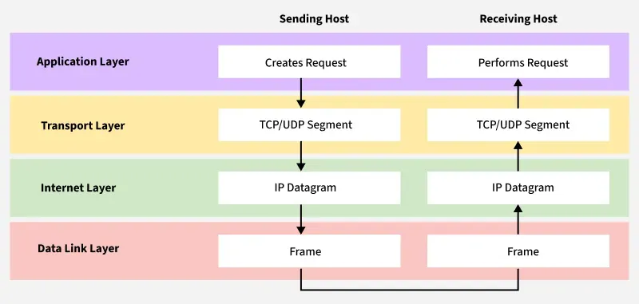

Slide 14
When Sending Data (From Sender to Receiver)
Application Layer: Prepares user data using protocols like HTTP, FTP, or SMTP.
Transport Layer (TCP/UDP): Breaks data into segments and ensures reliable (TCP) or fast (UDP) delivery.
Internet Layer (IP): Adds IP addresses and decides the best route for each packet.
Link Layer (Network Access Layer): Converts packets into frames and sends them over the physical network.
When Receiving Data (At the Destination)
Link Layer: Receives bits from the network and rebuilds frames to pass to the next layer.
Internet Layer: Checks the IP address, removes the IP header, and forwards data to the Transport Layer.
Transport Layer: Reassembles segments, checks for errors, and ensures data is complete.
Application Layer: Delivers the final data to the correct application (e.g., displays a web page in the browser).

Slide 15
1.5 Comparison between OSI and TCP/IP Protocol Suite,
The OSI (Open Systems Interconnection) model and TCP/IP (Transmission Control Protocol/Internet Protocol) suite are both layered frameworks for understanding and designing network communication protocols, but they differ significantly in structure and practical use.
Comparison Between OSI and TCP/IP Protocol Suite
Feature/Aspect | OSI Model | TCP/IP Protocol Suite
Layers | 7 (Physical, Data Link, Network, Transport, Session, Presentation, Application) | 4 (Network Access, Internet, Transport, Application)
Design Approach | Theoretical, protocol-agnostic, used for teaching and analysis | Practical, protocol-oriented, developed for real-world networking
Layer Functions | Each layer has a distinct and isolated function | Layers are functionally flexible and sometimes overlap
Protocol Dependency | Does not specify protocols, only describes functions | Protocol suite with standardized protocols (e.g. IP, TCP, UDP, HTTP)
Session/Presentation | Defined as separate layers | Combined into application layer
Layer Implementation | Strict modular separation | Modular, but with integration across some layers
Usage & Deployment | Rarely implemented, educational and analytical reference | Basis for Internet and almost all modern networking
Flexibility | More rigid in definitions and separation | More adaptable for practical Internet evolution
Service Types | Both connection-oriented and connectionless services at network layer | Connectionless at network, reliability at transport layer (TCP)

Slide 16
OSI provides a seven-layer reference model ideal for understanding complex networking concepts.
TCP/IP is the foundational protocol suite that powers the real-world Internet, offering robustness, simplicity, and efficiency for practical use.
1.6 Layers in TCP/IP Protocol Suite
The TCP/IP Protocol Suite, the foundation of Internet communication, is structured into four main layers. Each layer is responsible for specific networking functions and passes data to the layers above or below.
Layer Name | Functions and Responsibilities | Protocol Examples
Application Layer | Provides network services directly to applications, including data formatting, encryption, connection management, and user interaction. Combines the OSI model's application, presentation, and session layers. | HTTP, FTP, SMTP, DNS, Telnet, SNMP
Transport Layer | Responsible for process-to-process communication, data segmentation, flow control, error detection, and reliable/unreliable delivery. | TCP (reliable), UDP (unreliable/fast)
Internet Layer | Handles logical addressing, routing of packets across networks, packet fragmentation, and best-path selection for data. | IP (IPv4, IPv6), ICMP, ARP, IGMP
Network Access Layer (Link Layer) | Deals with the physical transmission of data over a local network segment, including MAC addressing, framing, and hardware signaling. | Ethernet, Wi-Fi, PPP, ARP

Slide 17
Key Points
The Application Layer is the uppermost, supporting user-facing protocols such as web, email, and file transfer.
The Transport Layer makes sure data from applications reaches the correct process on the destination, reliably (TCP) or quickly (UDP).
The Internet Layer is responsible for addressing and routing data packets so they traverse multiple networks and reach the right endpoint.
The Network Access Layer manages sending and receiving bits over the physical network medium, interfacing with hardware and determining how data frames are created and checked.
1.7 Addressing: Physical Addresses, Logical Addresses, Port Addresses, Application-Specific Addresses
In computer networks, addressing refers to assigning unique identifiers to devices, processes, or applications to enable proper communication. Different layers use different types of addresses for distinct purposes.

Slide 18
Types of Addresses in TCP/IP Networks
Address Type | Layer Used | Description and Example
Physical Address (MAC) | Network Access Layer | Unique identifier assigned to each network interface card (NIC). Used for local delivery of frames within the same LAN. Example:09:1A:34:08:2E:4F
Logical Address (IP) | Internet Layer | Uniquely identifies hosts on the network, regardless of physical location. Used for end-to-end delivery of packets. Example:192.168.1.1(IPv4),2409:4073:30e9::4d(IPv6)
Port Address | Transport Layer | Identifies the specific process or application on a host. Enables communication to services like HTTP, FTP, SMTP. Example: Port 80 (HTTP), Port 25 (SMTP)
Application-Specific Address | Application Layer | Easy-to-remember identifiers that map to services or resources. Examples include email addresses ([email protected]), URLs (www.example.com)

Slide 19
How These Addresses Work Together
Physical (MAC) Address: Used for communication within the same network segment, ensuring that frames reach the correct device on a LAN.
Logical (IP) Address: Used for routing packets between different networks, uniquely identifying each device globally.
Port Address: Used to direct data to the correct process/application on a device after the packet reaches its destination.
Application-Specific Addresses: Present user-friendly means of accessing resources; these are translated by protocols (like DNS for URLs or email servers for email addresses) into the appropriate network or transport addresses.

